Slide 1
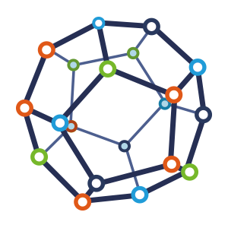


Computer Network
Class VI
lab 5

Slide 2
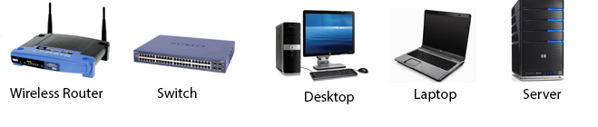
Network Devices
Networking hardware, also known as network equipment or computer networking devices

Slide 3
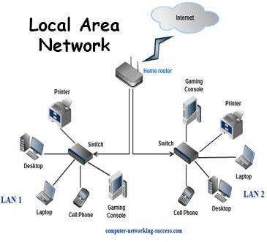
LAN
A LAN (local area network) is a computer network that interconnects computers within a limited area such as a residence, school, laboratory, university campus or office building

Slide 4
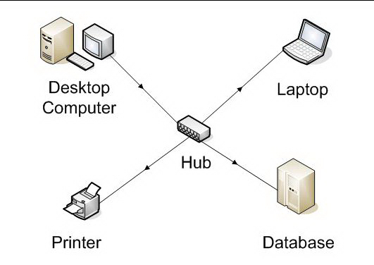
Hub
Hub is commonly used to connect segments of a LAN (Local Area Network)

Slide 5
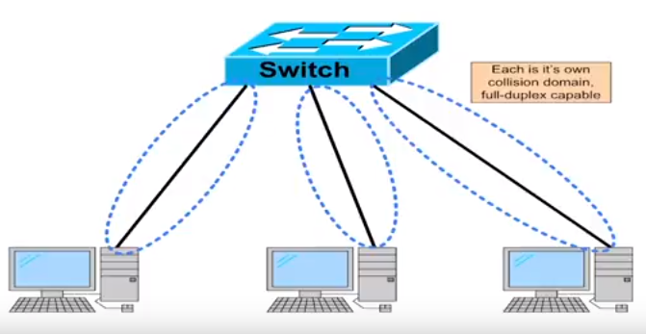
Switch
A network switch is a computer networking device that connects devices on a computer network by using packet switching

Slide 6
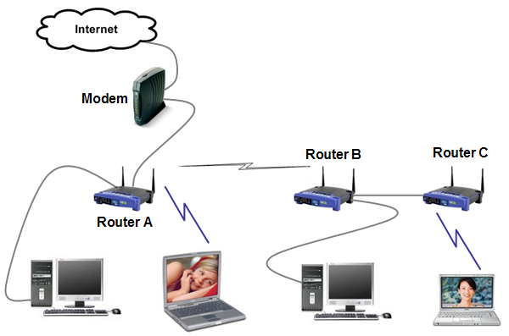
Router
A router is connected to at least two networks, commonly two LANs or WANs

Slide 7
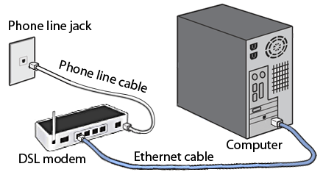
Modem
A modem is a hardware device that converts data between transmission media so that it can be transmitted from computer to computer

Slide 8



